Slide 1



Loan Default Prediction using
Machine Learning
Made by-
Gaurang Patil (1814046)
Abhishek Potdar (1814048)
Manav Punjabi (1814049)

Slide 2
Problem Definition
Several banks rely on credit scores for determining if loans can be sanctioned to a particular customer or not. It is important to know the credit worthiness of a particular loan applicant as it helps them decide whether a loan can be sanctioned or not. Defaulters can cause a significant amount of losses for the bank, which makes loan default prediction a necessity. As machine learning has gathered traction, banks are now leveraging machine learning to predict if loans should be sanctioned or not. The objective here is to build machine learning models to predict loan default prediction using given dataset.

Slide 3
Introduction
Importance of loan default prediction
Bank profits
Consequences of wrong predictions and identity frauds
Traditional Credit scoring V/S Modern ML
Classification problem in supervised learning
Modern developments: Federated learning

Slide 4
Dataset Used
Bank Loan Status Dataset from Kaggle
Loan ID | Monthly debt
Customer ID | Years of credit history
Current Loan Amount | Months since last delinquent
Term | Number of open accounts
Credit Score | Number of credit problems
Annual Income | Current credit balance
Years in current job | Maximum Open credit
Home ownership | Bankruptcies
Purpose | Tax Liens

Slide 5

Tools Used
Programming Language
Python
Coding Environment
Google Colab
Libraries
Pandas
Matplotlib
Scikit learn

Slide 6
EDA
Outlier Detection and Handling
Filling Missing Values
Discretization
Normalisation
Sampling

Slide 7
Models Used
LOGISTIC REGRESSION
RANDOM FOREST
XGBOOST
CATBOOST
NEURAL NETWORK

Slide 8
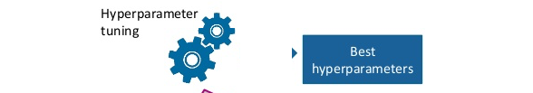
Techniques Used For Hyperparameter Tuning
GridSearchCV
RandomSearchCV

Slide 9
Evaluation Techniques
Confusion Matrix
Accuracy
Precision
Recall
F1 score
 | Actually Positive | Actually Negative
Predicted Positive | TP | FP
Predicted Negative | FN | TN

Slide 10
Results
 | Accuracy | Precision | Recall
Logistic Regression | 82.06% | 81.21% | 99.98%
Random Forest Classifier | 82.07% | 81.21% | 100%
XGBoost Classifier | 82.29% | 81.6% | 99.6%
CatBoost Classifier | 82.19% | 81.47% | 99.69%
Neural Network | 77.51% | 77.51% | 100%

Slide 11
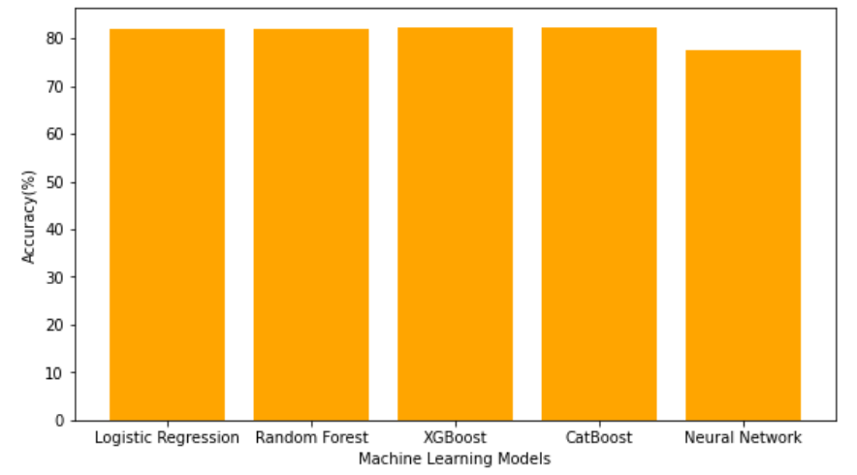
Graph

Slide 12
Conclusion
Finance institutions can take necessary measures to avert loan default if the risk associated with a certain loan record can be predicted ahead of time.
We executed various algorithms on our dataset such as Random Forest, KNN, Logistic Regression, XGBoost, CatBoost Classifier and Neural Network along with hyper tuning optimization.
Among those XG Boost gave the best accuracy of 82.29% for loan default prediction.

Slide 13
References
G. Shingi, "A federated learning based approach for loan defaults prediction," 2020 International Conference on Data Mining Workshops (ICDMW), 2020, pp. 362-368, doi: 10.1109/ICDMW51313.2020.00057.
Z. Ereiz, "Predicting Default Loans Using Machine Learning (OptiML)," 2019 27th Telecommunications Forum (TELFOR), 2019, pp. 1-4, doi: 10.1109/TELFOR48224.2019.8971110.
S. Barua, D. Gavandi, P. Sangle, L. Shinde and J. Ramteke, "Swindle: Predicting the Probability of Loan Defaults using CatBoost Algorithm," 2021 5th International Conference on Computing Methodologies and Communication (ICCMC), 2021, pp. 1710-1715, doi: 10.1109/ICCMC51019.2021.9418277.
A. Al-qerem, G. Al-Naymat and M. Alhasan, "Loan Default Prediction Model Improvement through Comprehensive Preprocessing and Features Selection," 2019 International Arab Conference on Information Technology (ACIT), 2019, pp. 235-240, doi: 10.1109/ACIT47987.2019.8991084.
S. K. Shaheen and E. ElFakharany, "Predictive analytics for loan default in banking sector using machine learning techniques," 2018 28th International Conference on Computer Theory and Applications (ICCTA), 2018, pp. 66-71, doi: 10.1109/ICCTA45985.2018.9499147.
M. A. Sheikh, A. K. Goel and T. Kumar, "An Approach for Prediction of Loan Approval using Machine Learning Algorithm," 2020 International Conference on Electronics and Sustainable Communication Systems (ICESC), 2020, pp. 490-494, doi: 10.1109/ICESC48915.2020.9155614.
T. Deng, "Study of the Prediction of Micro-Loan Default Based on Logit Model," 2019 International Conference on Economic Management and Model Engineering (ICEMME), 2019, pp. 260-264, doi: 10.1109/ICEMME49371.2019.00058.

Slide 14

THANK YOU
Code

